Slide 1

Acceleration Data

Slide 2

Data Types
Fitbit Data
Wavelet Data
Awake
Sleep
X Axis
Y Axis
Z Axis
This Photo by Unknown Author is licensed under CC BY-SA

Slide 3
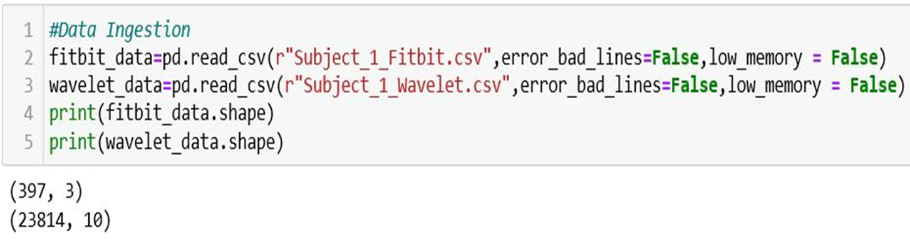
Data Ingestion
In Fitbit Data
Rows #397 & Columns # 3
In Wavelet Data
Rows # 23814 & Columns # 8

Slide 4
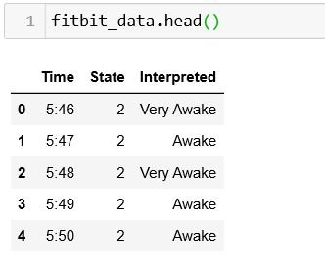
Fitbit Data

Slide 5
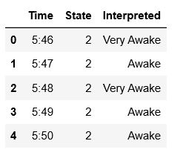
Task #1
In Fitbit Data change Very Awake to Awake
Hints: Using python Function to replace

Slide 6
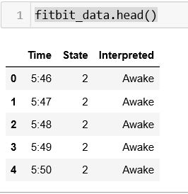
The Answer Should be like this:

Slide 7
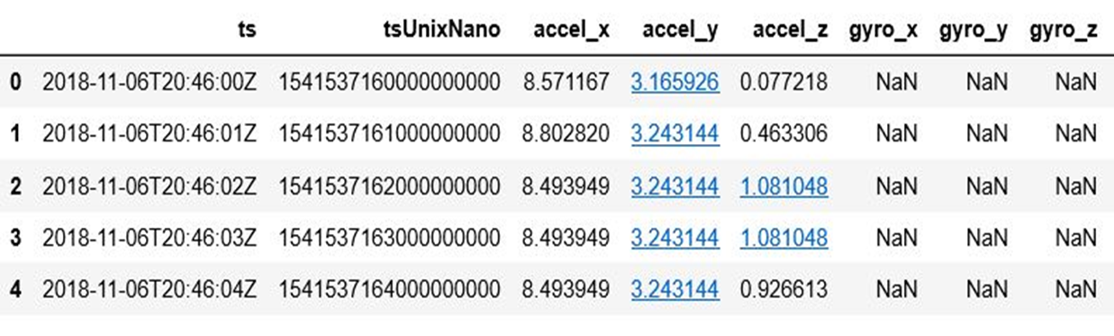
Wavelet Data

Slide 8

Task #2
Change Time Nano Second to second & Mints
Hints : https://www.unixtimestamp.com/index.php
Hints : using python datetime function

Slide 9
Convert Time Nanosecond to Seconds
tuUnixNano/1000000000
H:M
H:M:S

Slide 10
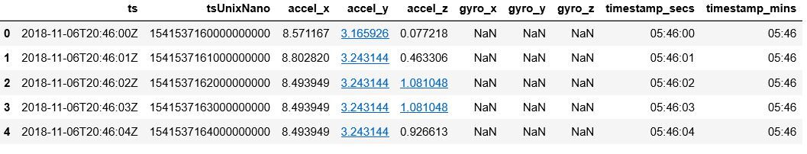
The Answer Should be like this:

Slide 11
Task #3
In Fitbit Data Find Start and End Time
Hints : Using python

Slide 12
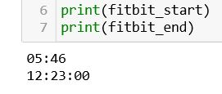
The Answer Should be like this:

Slide 13
Task #4
In Wavelet Data
Using abs function change any negative value to positive value
Find Absolute value of( accel_x , accel_y , accel_z )
Hints : Using Python abs function

Slide 14
Find Absolute Value
X Axis(2,-3)
abs
X Axis(2,3)
Y Axis(4,-5)
Y Axis(4,5)
Z Axis(-7,8)
Z Axis(7,8)

Slide 15
Task # 5
In Wavelet Data
Collapsing the Rows Of Raw Data to a 60 Seconds Epochs
Every 60 second count as 1 Mints
Hints : Using Python sum & groupby Function

Slide 16
Fitbit 과 wavelet의 측정 단위가 달라서 60초까지의 x,y,z를 더해서 1분단위로 사용
X(1,2,3…60)
X(1)
(2)
Sum
y(1,2,3…60)
Y(1)
(2)
z(1,2,3…60)
Z(1)
(2)

Slide 17
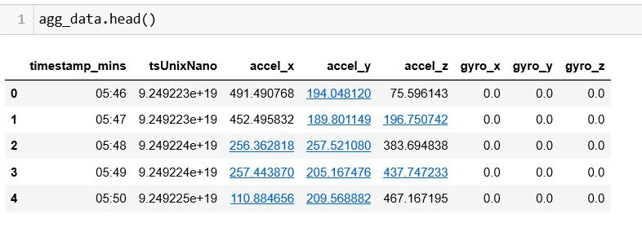
The Answer Should be like this:

Slide 18
Task #6
루트(x^2+y^2+z^2)=a의 즉 x,y,z를 하나의 a라는 값으로 만든것이 resultant vector 값이다.
In Wavelet Data
Find the Resultant Vector of ( accel_x , accel_y , accel_z )
Hints : Create User define function in Python

Slide 19
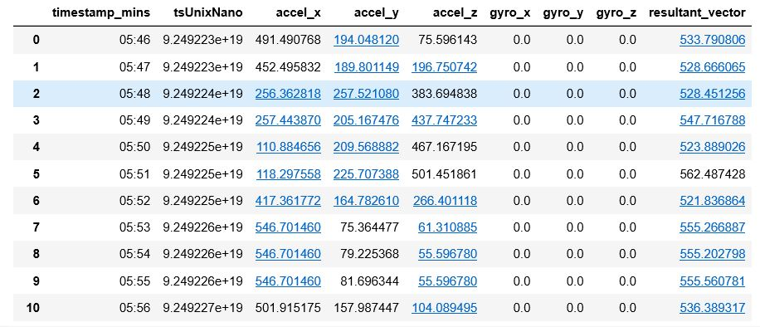
The Answer Should be like this:

Slide 20
Task #7
Calculate the Mean of Resultant Vector
Hints : Using Python Mean function

Slide 21
Find Resulting Vector and Mean
Result Vector
X Axis
Mean
Y Axis
Z Axis
OutPut

Slide 22
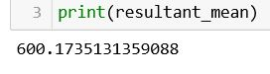
The Answer Should be like this:

Slide 23
Task #8
Sleep 이냐 awake이냐 를 구별하는 문제
Identifying The Vibration Mechanism
Least Vibration Threshold ( accel_x , accel_y , accel_z )
Hints : Create User define function

Slide 24
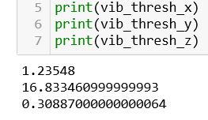
The Answer Should be like this:

Slide 25
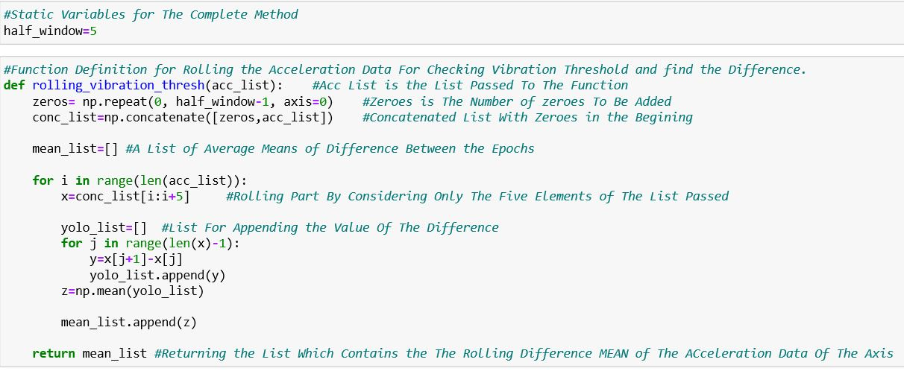
Rolling the Acceleration Data
0
0
0
0
x1
x1
Y1=x2-x1
y1
x2
x2
Y2=x3-x2
y2
x3
x3
z5=mean(y1,y2,y3,y4)
z5
x4
Y3=x4-x3
y3
x4
x5
Y4=x5-x4
y4
x5
x6
x7
xn

Slide 26
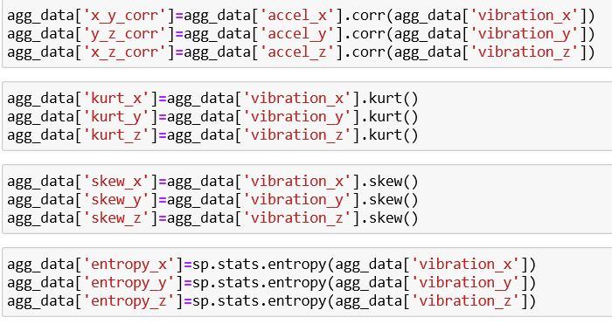
Feature Engineering

Slide 27
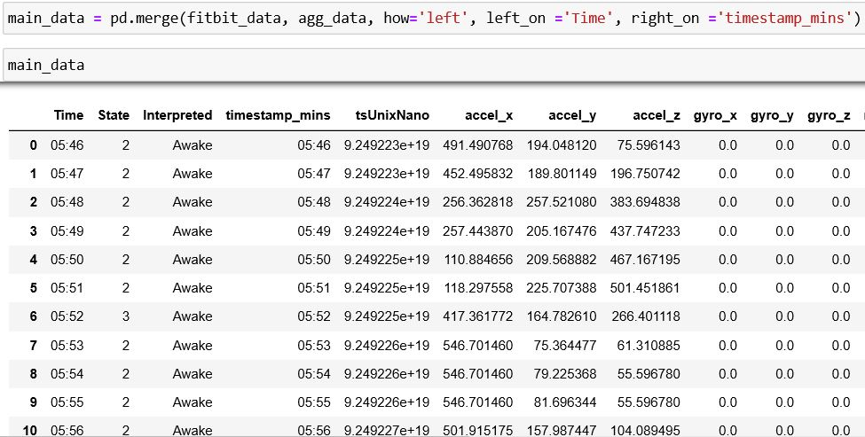
Join Fitbit and Aggregate Data
Fitbit Data
Join
Aggregate Data
New Data

Slide 28
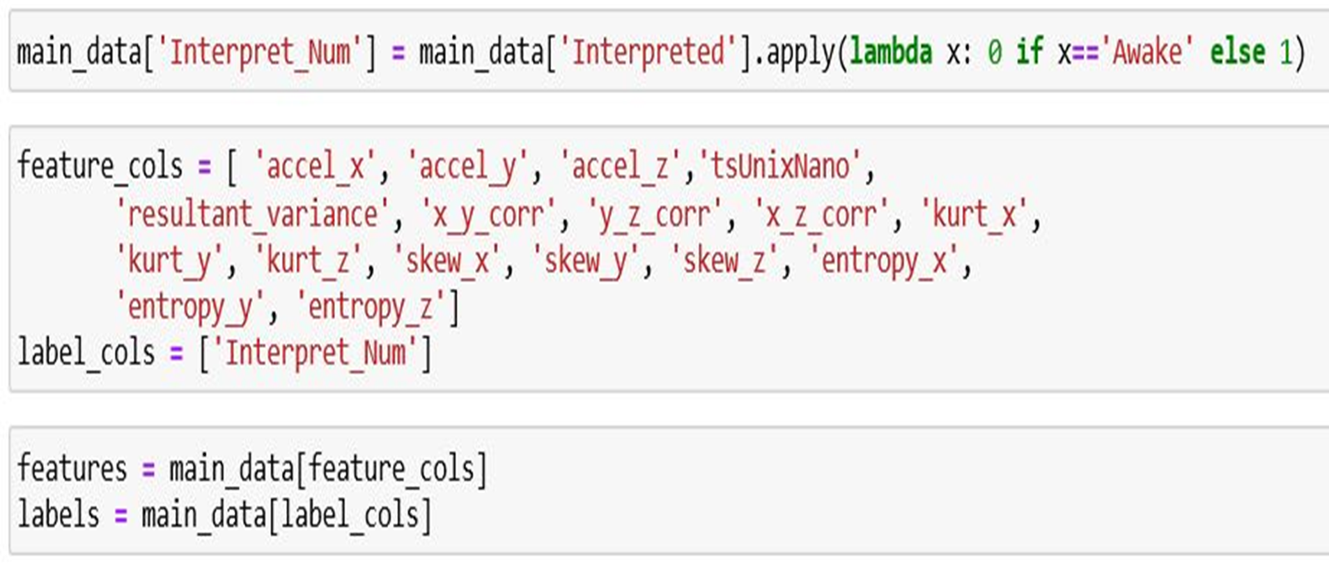
Features and label columns

Slide 29
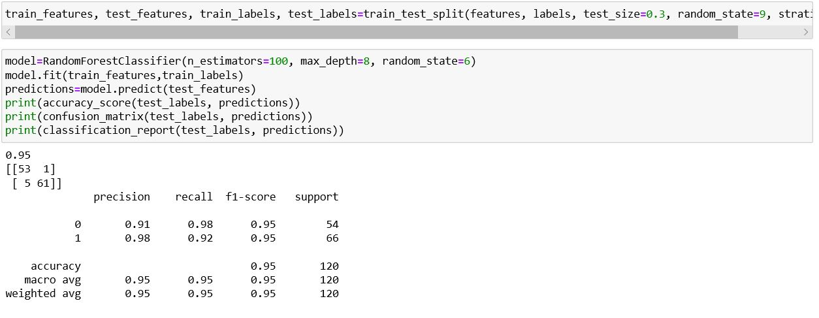
Train the Model And Accuracy

Slide 30
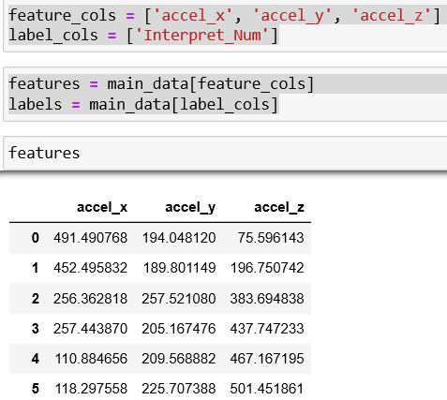
If We Select three Features columns

Slide 31
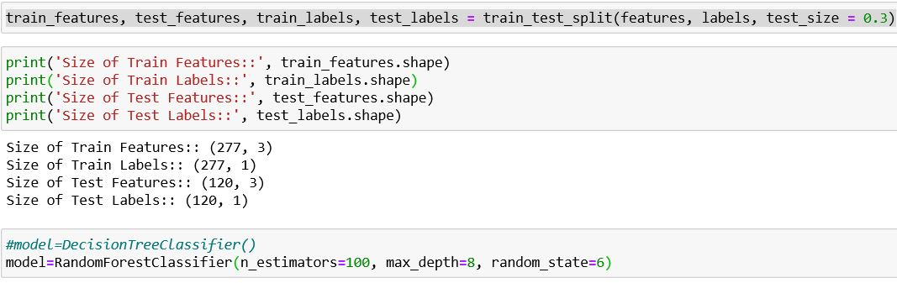
Train the Model

Slide 32
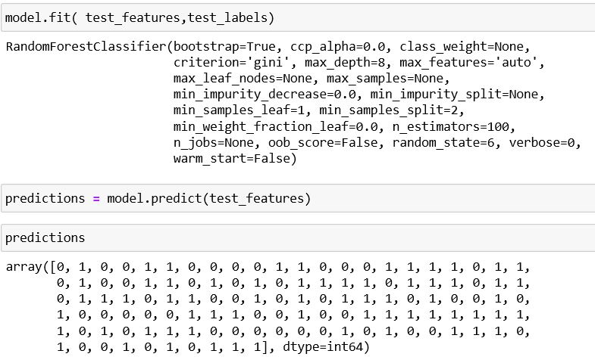
Prediction

Slide 33
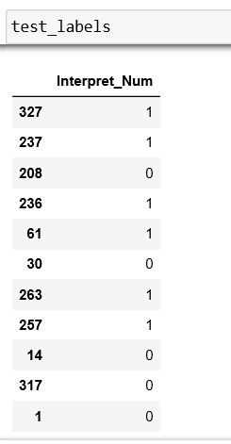
Test Label

Slide 34
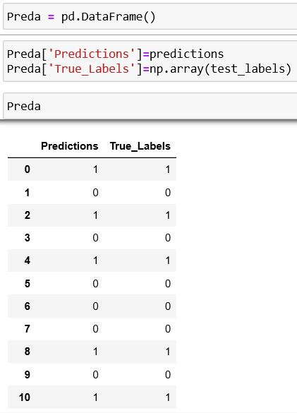
Prediction and True Labels

Slide 35
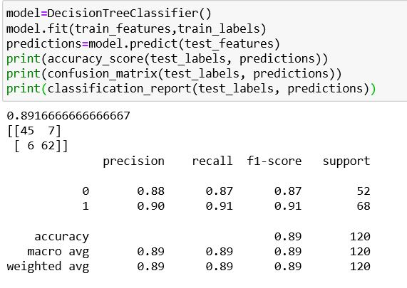
Decision Tree Classifier

